Slide 1
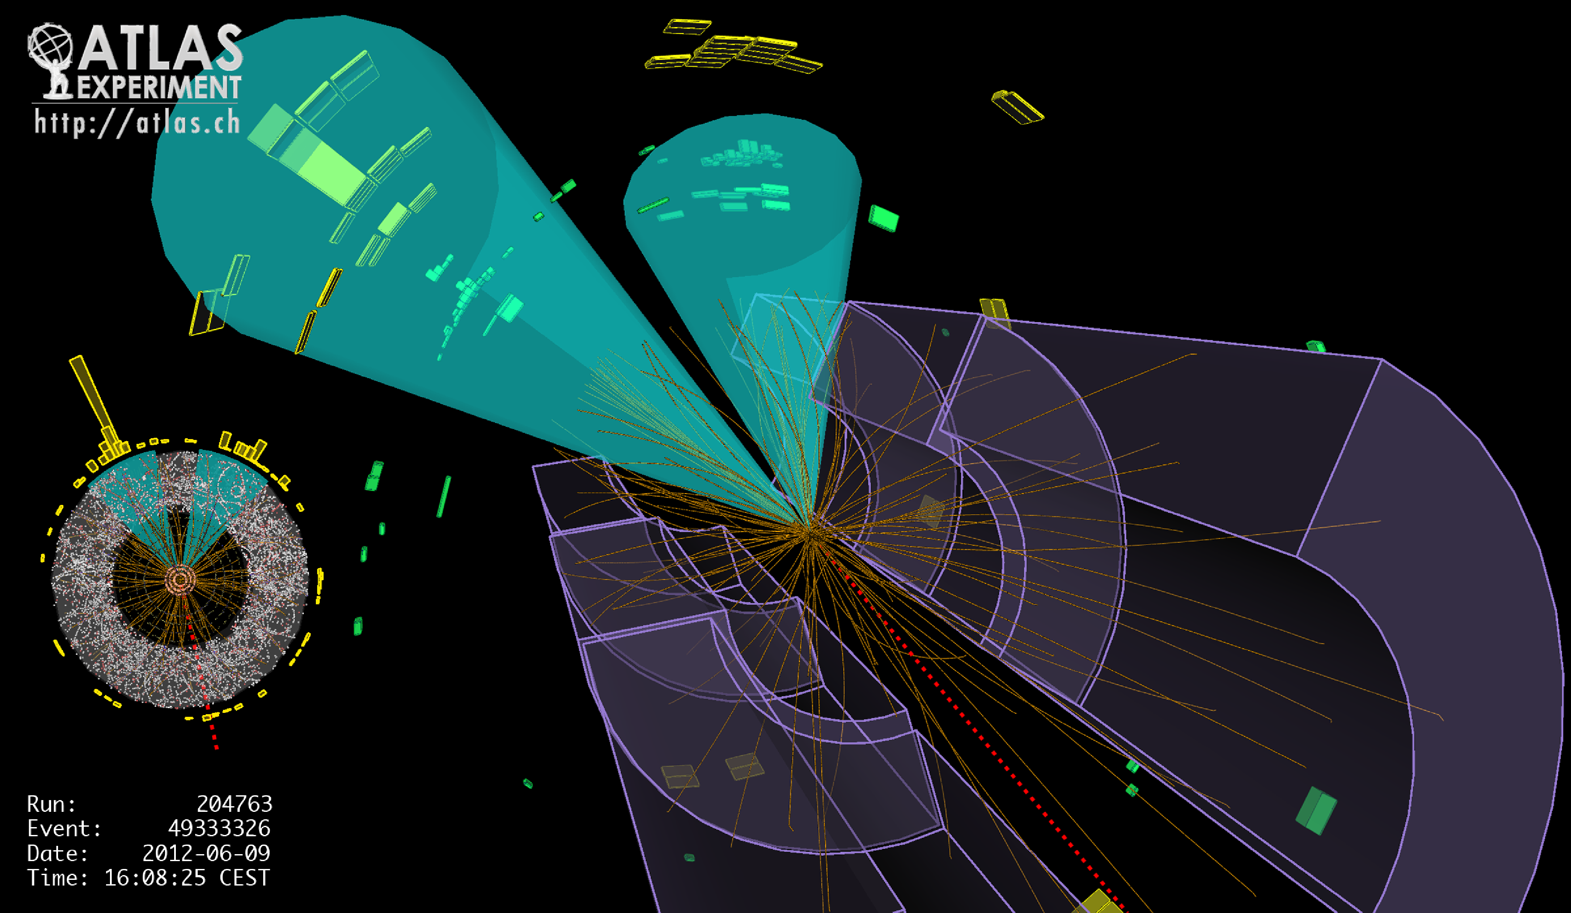
Lecture #8
Prof. Dr. Florencia Canelli
Universität Zürich
Elementary particle physics - PHY451
HS2016

Slide 2
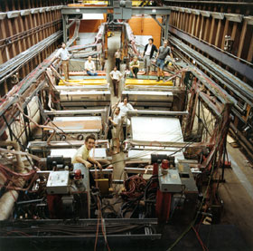
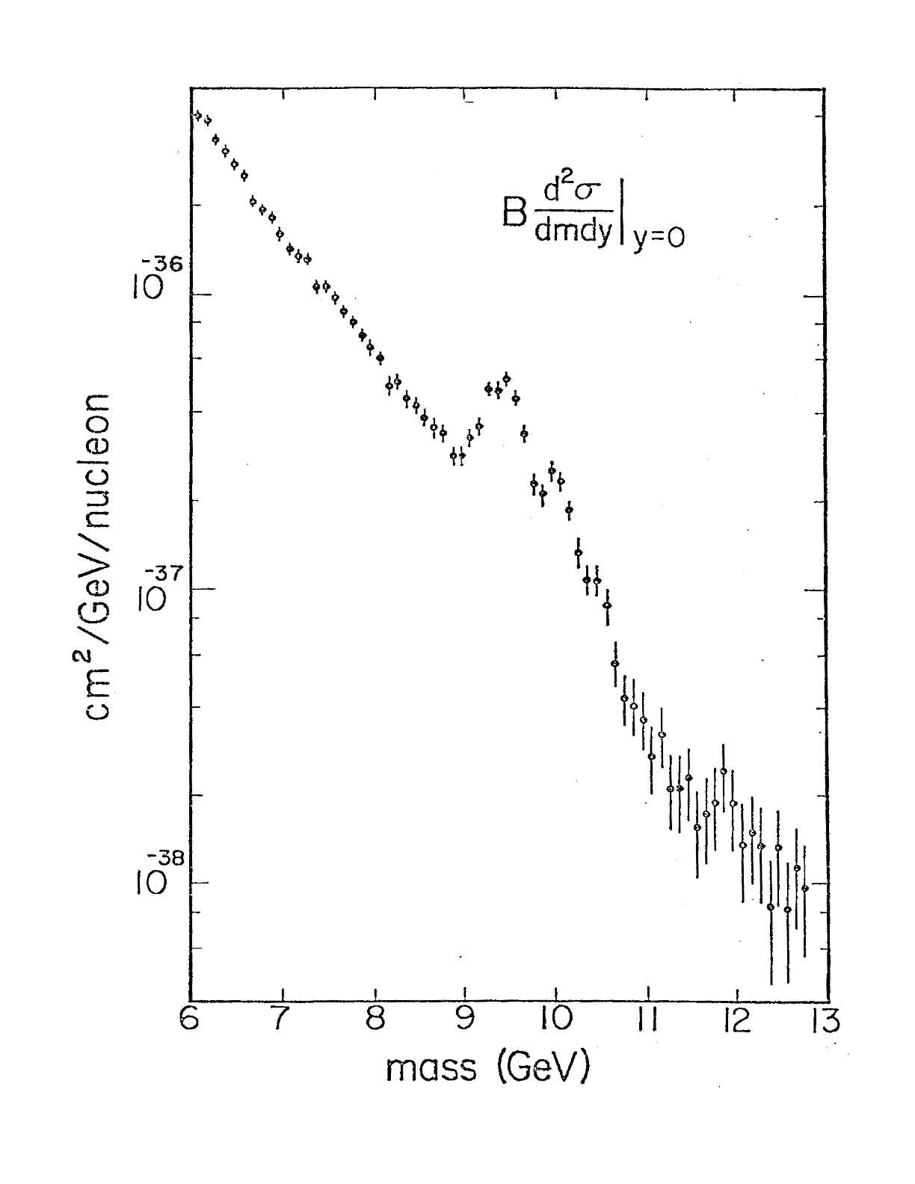
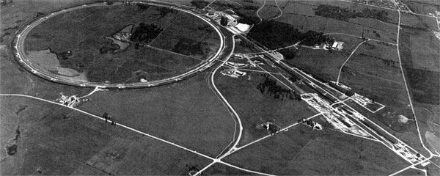
The fifth quark
Fermilab
As soon as the Υ meson was discovered it was interpreted as the 1³S₁ state of the bottonium
At present many levels of ³S₁ and ³P states have been observed
(more on tomorrow’s presentation)

Slide 3
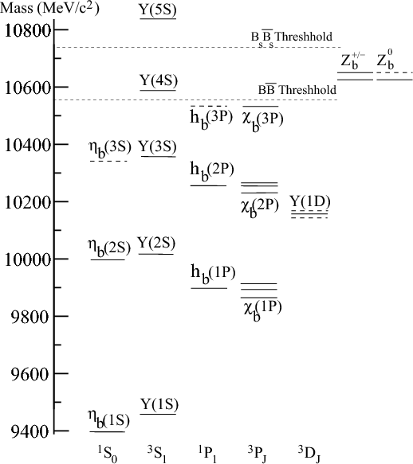
Bottonium

Slide 4
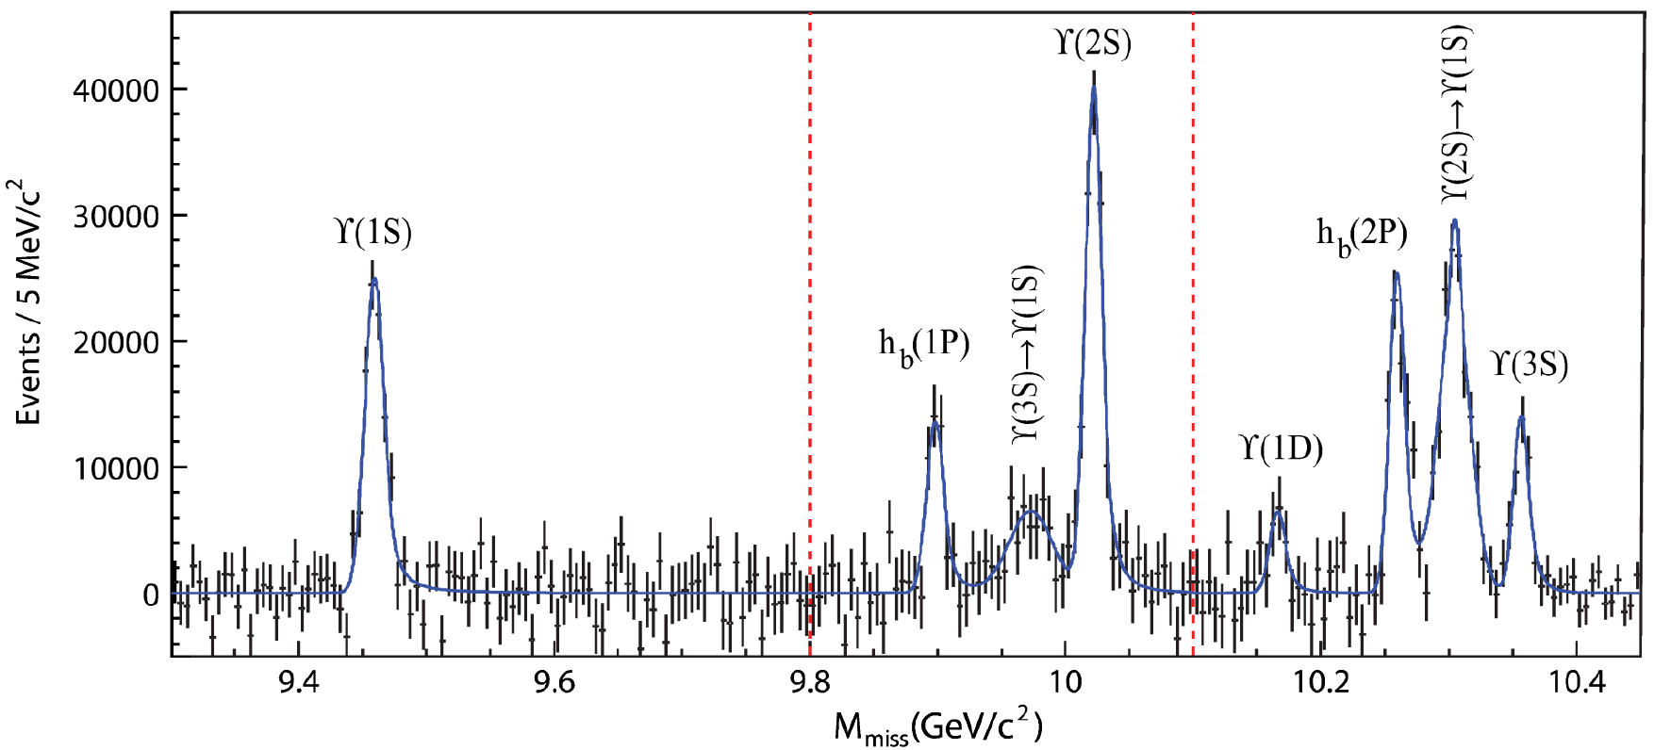
Bottonium today
Search for new states
And transitions among states
Measurements of cross sections (also differential) and polarizations
Help understand the subtleties and limitations of perturbative and non-perturbative QCD

Slide 5
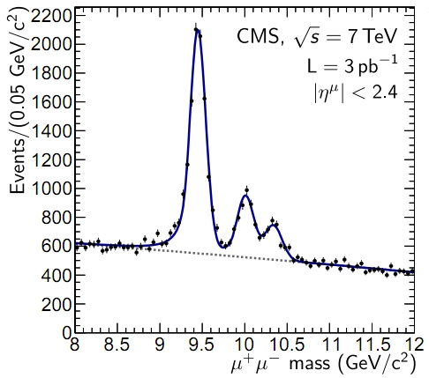
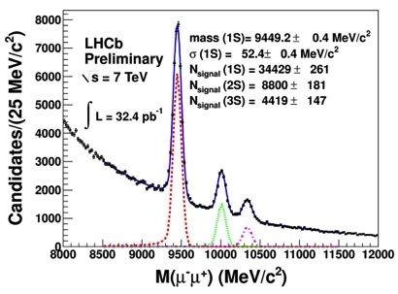
Bottonium today
Studying these bound states still allows us to learn about strong interactions

Slide 6
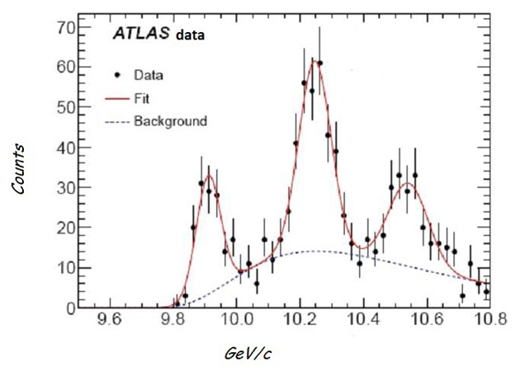
Bottonium today
New bound state found slightly heavier than predicted, meaning the quark anti-quark is a little loosely bound than expected
NEW 2013

Slide 7
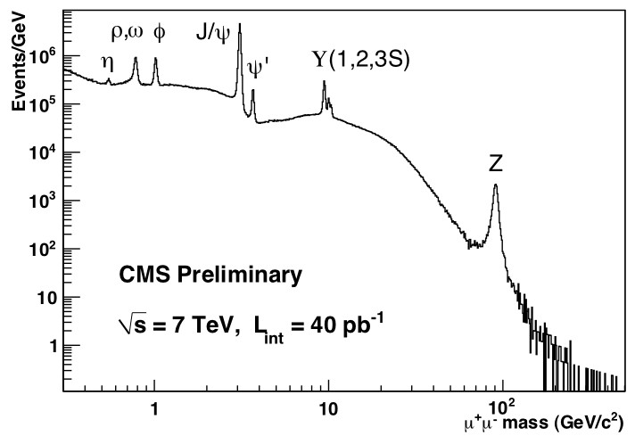
Spectrum of bound states
Scanning over the μ⁺μ⁻ spectrum we find many resonances
Excellent source of calibration of the measured muon momenta

Slide 8


Quarks
How do we know the proton isn’t fundamental “point-like”particle ?
Study of electron-proton scattering as a probe of the structure of the proton
e–
e–
e–
e–
p
p
p

Slide 9
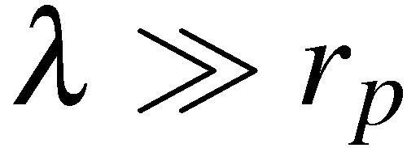
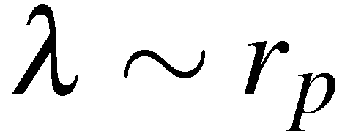
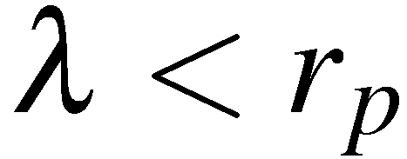
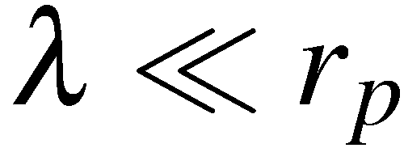
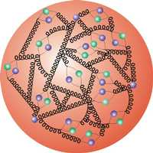
Probing the structure of the proton
In e⁻p → e⁻p scattering the nature of the interaction of the virtual
photon with the proton depends strongly on wavelength
At very low electron energies :
the scattering is equivalent to that from a
“point-like” spin-less object
e–
e–
At low electron energies :
the scattering is equivalent to that from a
extended charged object
At high electron energies :
the wavelength is sufficiently short to
resolve sub-structure. Scattering from
constituent quarks
e–
At very high electron energies :
the proton appears to be a sea of
quarks and gluons.
e–

Slide 10
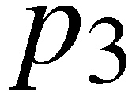


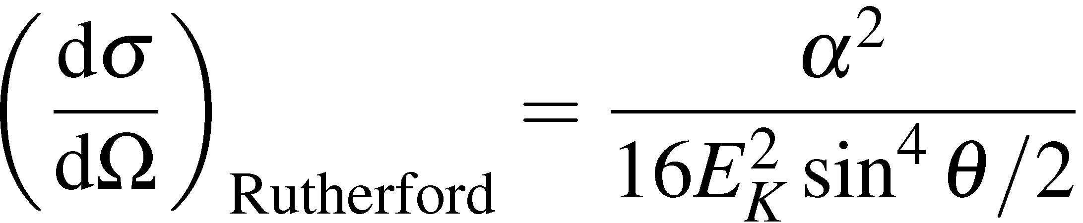
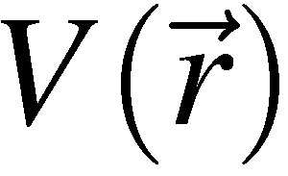
Scattering – non relativistic
Rutherford scattering is the low energy
limit where the recoil of the proton can be
neglected and the electron is non-relativistic
e–
e–
(neglect proton recoil)
This is the normal expression for the Rutherford cross section. It can
be derived by considering the scattering of a non-relativistic particle in the
static Coulomb potential of the proton , without any consideration of the
interaction due to the intrinsic magnetic moments of the electron or proton.
In this non-relativistic limit only the interaction between the electric charges
of the particles matters

Slide 11

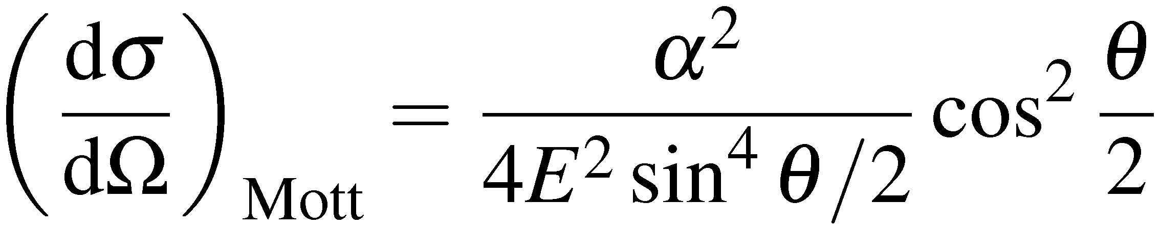
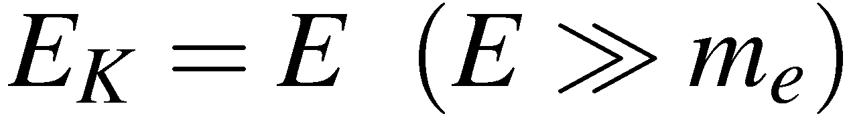
Scattering – relativistic
For Rutherford scattering we are in the limit where the target recoil is
neglected and the scattered particle is non-relativistic
The limit where the target recoil is neglected and the scattered particle is
relativistic (i.e. just neglect the electron mass) is called Mott Scattering
Rutherford formula
with
Overlap between initial/final
state electron wave-functions.
Just QM of spin ½
NOTE: we could have derived this expression from scattering of
electrons in a static potential from a fixed point in space .
The interaction is ELECTRIC rather than magnetic (spin-spin) in nature.
Still haven’t taken into account the charge distribution of the proton…..

Slide 12
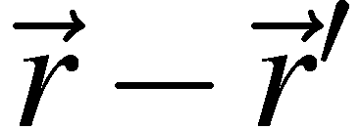

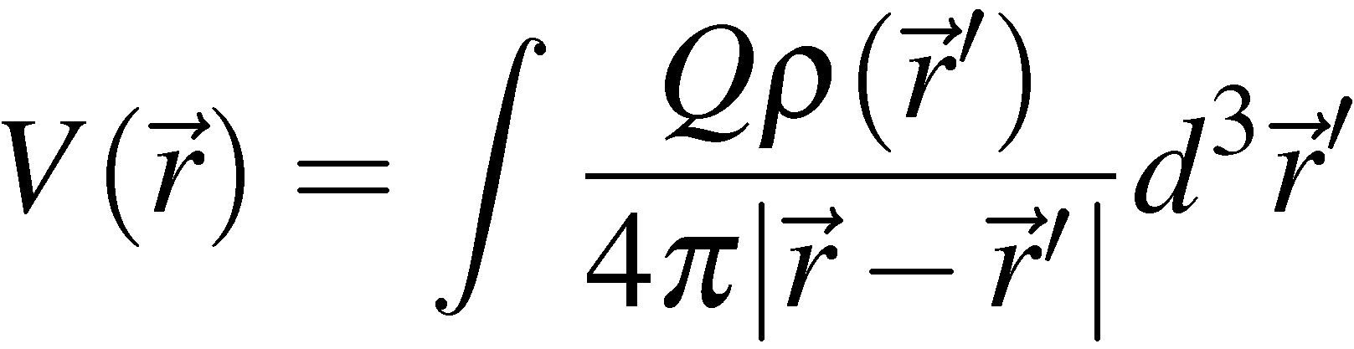

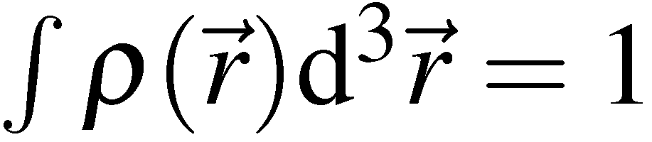
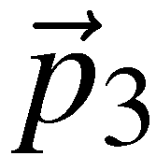
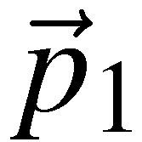
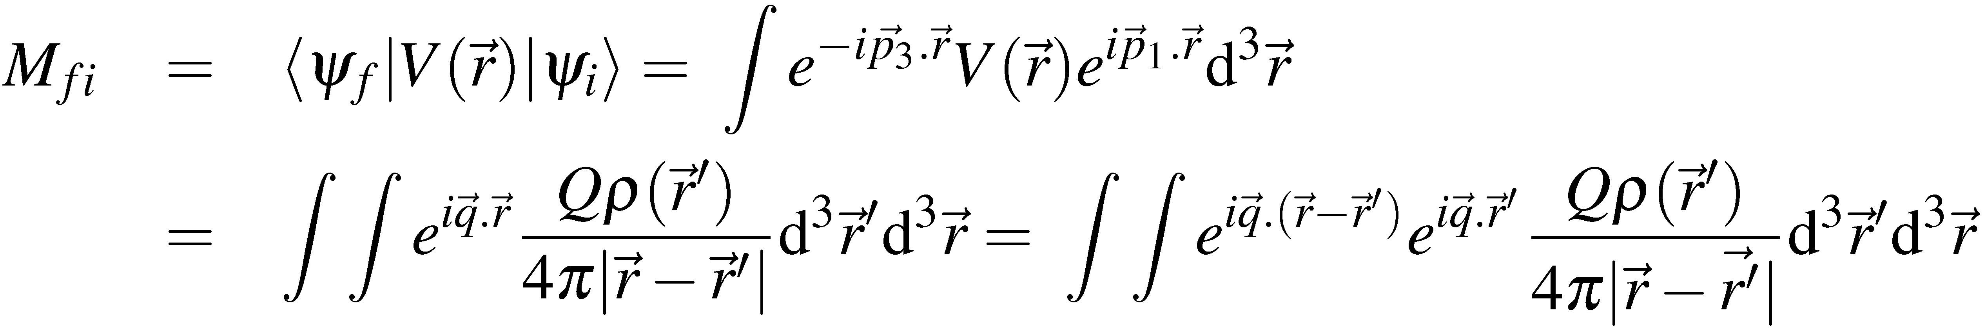
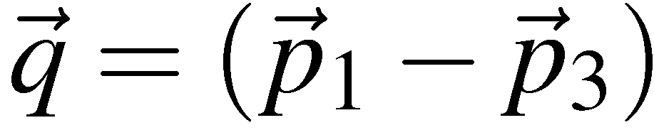
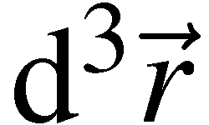
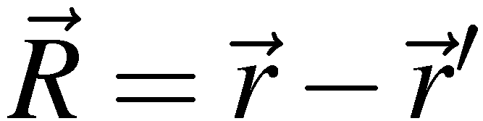
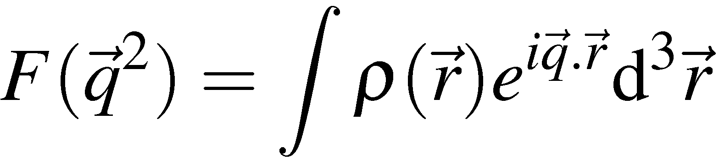
Scattering – relativistic + charge distribution
Consider the scattering of an electron in the static potential
due to an extended charge distribution.
The potential at from the centre is given by:
with
In first order perturbation theory the matrix element is given by:
Fix and integrate over with substitution
The resulting matrix element is equivalent to the matrix element for scattering
from a point source multiplied by the form factor

Slide 13
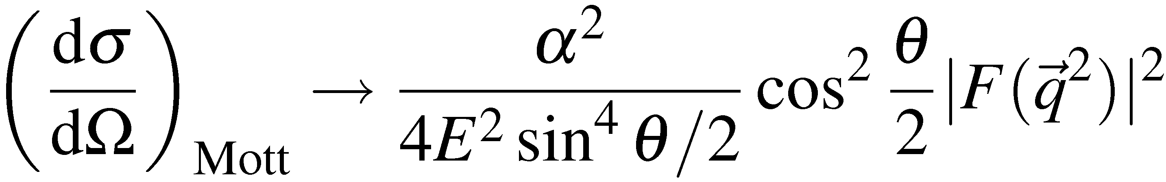
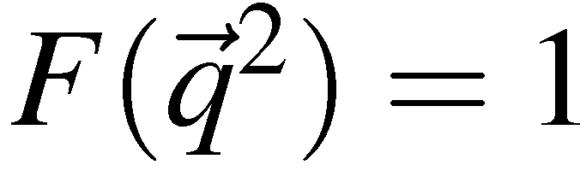
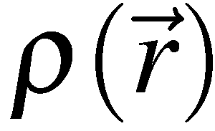
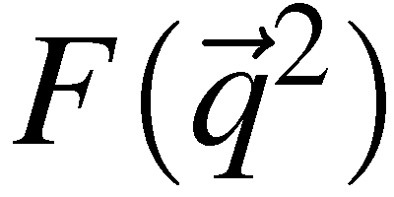
Scattering – relativistic + charge distribution
The finite size of the scattering centre
introduces a phase difference between
plane waves “scattered from different points
in space”. If wavelength is long compared
to size all waves in phase and
For example:
point-like
exponential
Gaussian
Uniform
sphere
Fermi
function
unity
“dipole”
Gaussian
sinc-like
Dirac Particle
Proton
⁶Li
⁴⁰Ca
NOTE that for a point charge the form factor is unity.

Slide 14
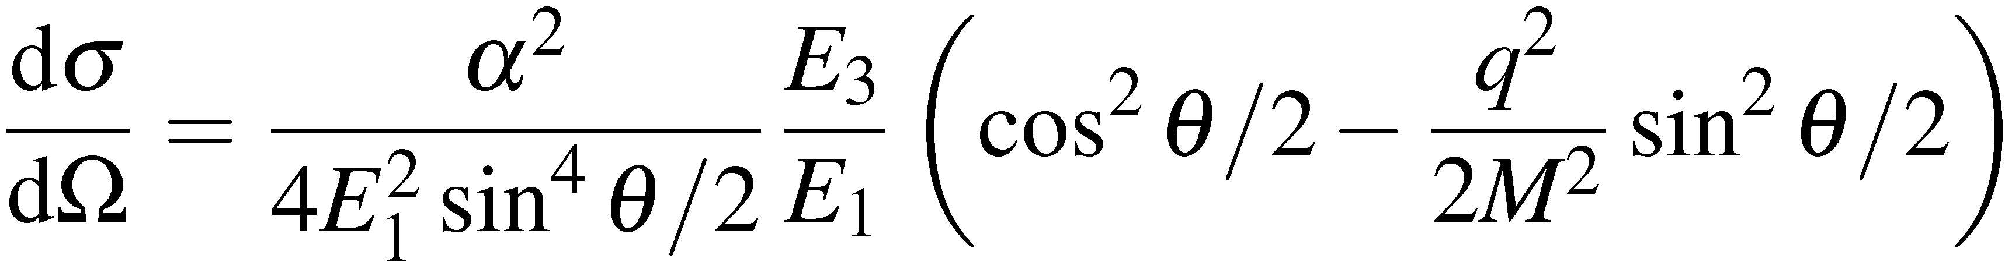
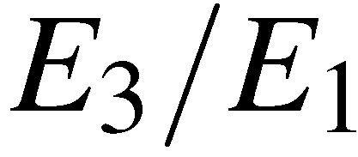
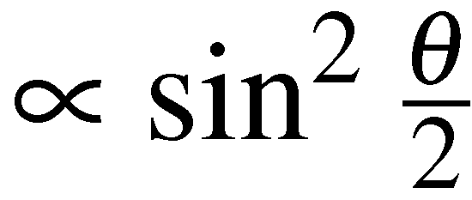
Scattering – relativistic + charge + proton recoil
This is the differential cross-section for e⁻p → e⁻p elastic
scattering assuming point-like Dirac spin ½ particles.
How should we interpret the equation?
Compare with
the important thing to note about the Mott cross-section is that it is equivalent
to scattering of spin ½ electrons in a fixed electro-static potential. Here the
term is due to the proton recoil.
the new term:
Magnetic interaction : due to the
spin-spin interaction

Slide 15
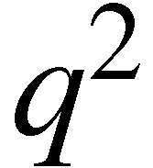
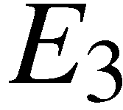
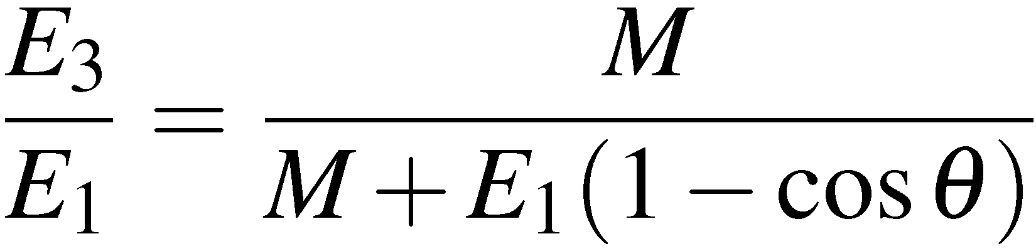
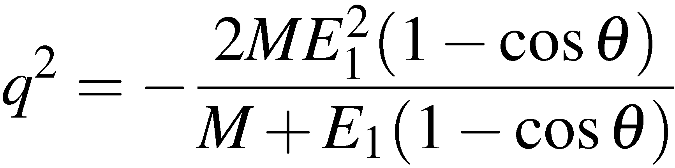
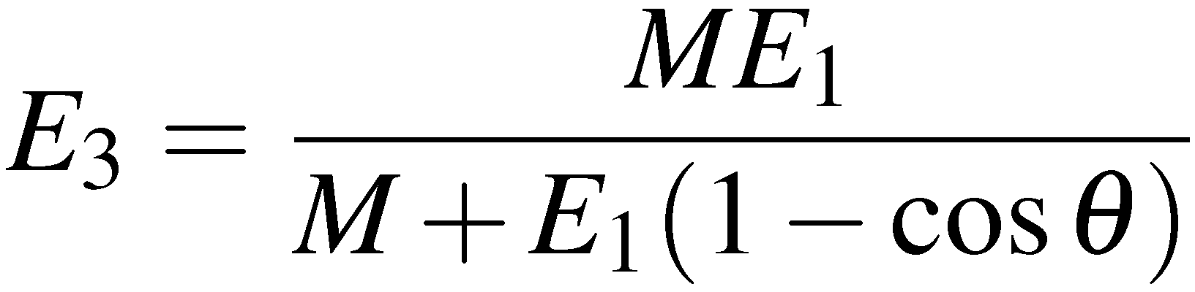
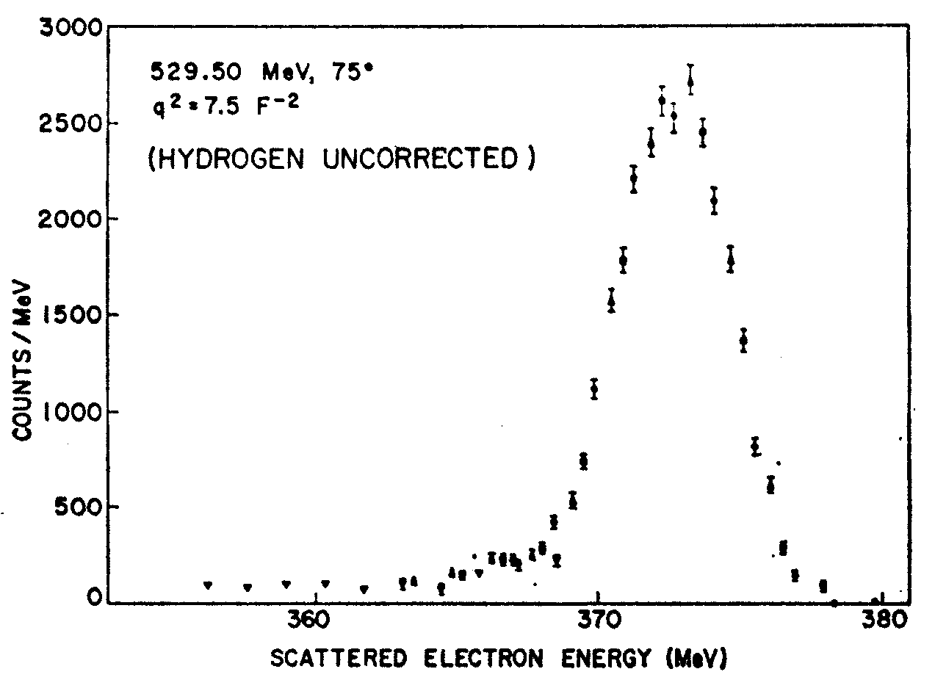
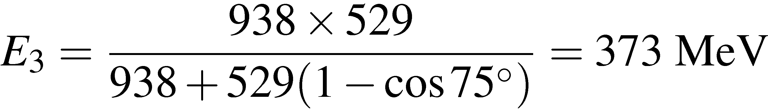
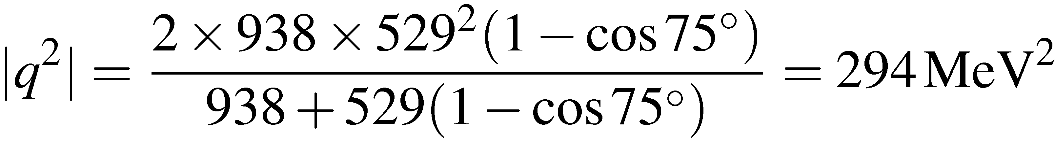
Scattering – relativistic + charge + proton recoil
The above differential cross-section depends on a single parameter. For an electron
scattering angle , both and the energy, , are fixed by kinematics
e.g. e⁻p → e⁻p at E_{beam}= 529.5 MeV,
look at scattered electrons at θ = 75º
For elastic scattering expect:
E.B.Hughes et al., Phys. Rev. 139 (1965) B458
The energy identifies the scatter as elastic.
Also know squared four-momentum transfer

Slide 16
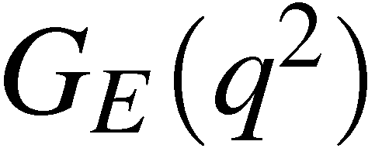
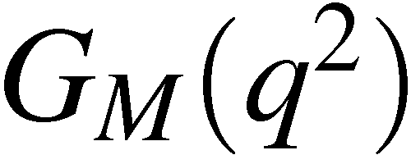
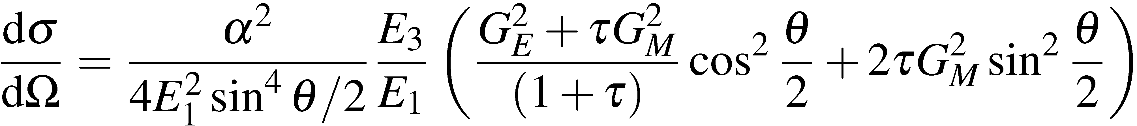
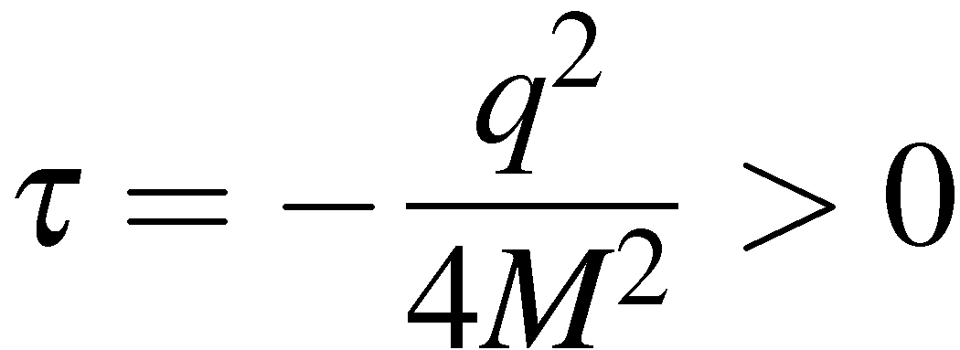
Scattering – relativistic + charge + p recoil + p size
In general the finite size of the proton can be accounted for by introducing
two structure functions. One related to the charge distribution in the proton,
and the other related to the distribution of the magnetic moment of the proton,
It can be shown that it can be generalized to the ROSENBLUTH FORMULA
with the Lorentz Invariant quantity:

Slide 17
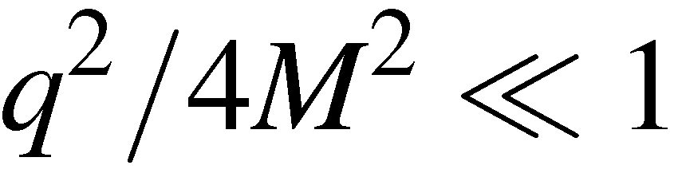






Scattering – relativistic + charge + p recoil + p size
In the limit we can interpret the structure functions in
terms of the Fourier transforms of the charge and magnetic moment distributions
In the Rosenbluth formula it is assumed that the proton is a spin-half Dirac particle, i.e.
However, the experimentally measured value of the proton magnetic moment
is larger than expected for a point-like Dirac particle:
So for the proton expect
Of course the anomalous magnetic moment of the proton is already evidence
that it is not point-like !

Slide 18










Scattering – relativistic + charge + p recoil + p size
Express the Rosenbluth formula as:
where
i.e. the Mott cross-section including
the proton recoil. It corresponds
to scattering from a spin-0 proton
At very low q²:
At high q²:
In general we are sensitive to both structure
functions! These can be resolved from
the angular dependence of the cross
section at FIXED

Slide 19





Hofstader’s experiment
R. Hofstader
1954: first experiments by
Hofstadter showed that
proton has a finite size
(0.74 fm)

Slide 20












Scattering – measurements
EXAMPLE: e⁻p → e⁻p at E_{beam}= 529.5 MeV
Electron beam energies chosen to give certain values of
Cross sections measured to 2-3 %
q² = 293 MeV²
E.B.Hughes et al., Phys. Rev. 139 (1965) B458
NOTE
Experimentally find
G_{M}(q²) = 2.79G_{E}(q²),
i.e. the electric and
and magnetic form
factors have same
distribution

Slide 21


Proton radius today
https://www.quantamagazine.org/20160811-new-measurement-deepens-proton-radius-puzzle/
https://www.newscientist.com/article/2100834-how-big-is-a-proton-no-one-knows-exactly-and-thats-a-problem/

Slide 22


Higher energy e-p scattering
Use electron beam from SLAC LINAC:
5 < E_{beam} < 20 GeV
Detect scattered electrons using the
“8 GeV Spectrometer”
bending magnets
e⁻
12m
θ
High q²
Measure
P.N.Kirk et al., Phys Rev D8 (1973) 63

Slide 23







High q² results
Form factor falls rapidly with
Proton is not point-like, extended object
Good fit to the data with “dipole form”:
Point-like proton
Taking FT find spatial charge and magnetic
moment distribution
with
Corresponds to a rms charge radius
Although suggestive, does not
imply proton is composite !
Note: so far have only considered
ELASTIC scattering; INELASTIC
scattering comes next
R.C.Walker et al., Phys. Rev. D49 (1994) 5671
A.F.Sill et al., Phys. Rev. sD48 (1993) 29

Slide 24






High q² results
M.Breidenbach et al.,
Phys. Rev. Lett. 23 (1969) 935
Due to the finite proton size, elastic scattering
at high q² is unlikely and inelastic reactions
where the proton breaks up dominate.
e–
e–
θ
q
p
X

Slide 25










Inelastic scattering
Example: Scattering of 4.879 GeV electrons from protons at rest
Place detector at 10º to beam and measure the energies of scattered e–
Kinematics fully determined from the electron energy and angle !
e.g. for this energy and angle : the invariant mass of the final state
hadronic system
Elastic Scattering
proton remains intact
Inelastic Scattering
produce “excited states”
of proton e.g.
Deep Inelastic Scattering
proton breaks up resulting
in a many particle final state
DIS = large W

Slide 26

Inelastic cross sections
Repeat experiments at different angles/beam energies and determine
q² dependence of elastic and inelastic cross-sections
Elastic scattering falls of rapidly
with due to the proton not being
point-like (i.e. form factors)
Inelastic scattering cross sections
only weakly dependent on q²
M.Breidenbach et al.,
Phys. Rev. Lett. 23 (1969) 935
Deep Inelastic scattering cross sections
almost independent of q² !
i.e. “Form factor”  1
Scattering from point-like
objects within the proton !

Slide 27



Elastic →Inelastic scattering
Recall: Elastic scattering
Only one independent variable. In Lab. frame express differential cross
section in terms of the electron scattering angle (Rosenbluth formula)
Note: here the energy of the scattered electron is determined by the angle.
In terms of the Lorentz invariant kinematic variables can express this differential
cross section in terms of Q²
which can be written as:
Inelastic scattering
For Deep Inelastic Scattering have two independent variables. Therefore
need a double differential cross section

Slide 28






Deep inelastic scattering
It can be shown that the most general Lorentz Invariant expression
for e⁻p → e⁻X inelastic scattering (via a single exchanged photon is):
(1)
INELASTIC
SCATTERING
c.f.
ELASTIC
SCATTERING
We will soon see how this connects to the quark model of the proton
NOTE: The form factors have been replaced by the STRUCTURE FUNCTIONS
and
which are a function of x and Q²: can not be interpreted as the Fourier transforms
of the charge and magnetic moment distributions. We shall soon see that they
describe the momentum distribution of the quarks within the proton
In the limit of high energy (or more correctly ) eqn. (1) becomes:

Slide 29
Color and QCD
Impose Fermi statistics on known baryon states
Δ⁺⁺ = uu, spin=3/2, s-wave (l=l’=0): These are all symmetric under interchange of quarks
Need another degree of freedom to antisymmetrize!
must have at least 3 possible states, since we are antisymmetrizing 3 objects
Introduce a new quantum number: color
Colors exist in red, green, blue
Baryons and mesons have zero net color => observable hadrons are color singlets
The color singlet states are anti-symmetric under color exchange
By putting together 3 colors we obtain a color decuplet, 2 octets, and a color singlet
Nature chooses the singlet
This is an asymmetric wave

Slide 30

Color
All particle states observed in nature are “colorless”

Slide 31
From Color to QCD
Essential properties of the QCD theory
Quarks carry color as well as electric charge; there are 3 colors
Color is exchanged by eight bicolored massless gluons with a spin =1
Quark-gluon interactions are computed by the rules of QED ( α => α_{s} at each vertex)
Gluons can interact with other gluons
At short distances, α_{s} is small and we can compute color interaction using the QED perturbative techniques

Slide 32

Implications (I) - running α_{s}
Gluons can interact with other gluons
Great success of QCD: ability to explain why strong interactions are strong at low Q² but quarks act like free particles at high Q²
The coupling constant α_{s} is a function of Q²
Low Q² α_{s} large (confinement)
High Q² α_{s} small (asymptotic freedom)
The running of the coupling describes how the effective charge depends on the separation of the two charged particles

Slide 33
Implications (I) - running α_{s}
This running phenomenon was also found in QED
But α_{s} runs more slowly than α_{QED} and in opposite direction
For example at Q² = M²_{z} , α_{s}(M²_{Z} ) ~ 1/129
Running of α_{s} is a consequence of renormalization (more later)
Incorporation of infinities of the theory into the definitions of physical observables
The running of the coupling describes how the effective charge depends on the separation of the two charged particles

Slide 34
Implications (I) - running α_{s}
QED and QCD relate the value of the coupling constant at one Q² to that at another through renormalization procedure
Modifications for the strong interaction arise from the color self-coupling of the gluons
In a world with 16 quark flavors, coupling QCD = QED
Strength decreases with short distances, large Q²
μ renormalization scale
Q typical momentum transfer of the process

Slide 35
Implications (I) - running α_{s}
At what μ is the effective coupling becoming “large” ?
μ has dimensions of mass, relic from renormalization
It is customary to denote the Q² where α_{s} becomes large as
With this definition
Λ experimentally determined, typical hadronic mass, few hundred MeV
For Q²>>Λ², coupling is small and perturbation theory works
For Q²~Λ², physics is non-perturbative (quarks & gluons will arrange into hadrons)

Slide 36


Implications (I) - running α_{s}
Experimentally tested
Different techniques agree at a single Q²
Most measurements done at the M_{z} scale with LEP data

Slide 37
Tuesday lectures
Date | Topic | Student
Sept 27 | Positron (p9) Muon (p29) Pion (p34) | Nici Alex Kevin
Oct 4 | Unstable particles (p65 or p71) Anti-p (p87) or Anti-n (p94) | Lukas Oliver
Oct 11 | Omega-(p144) Parity violation in beta (p163) Parity violation in pions (165) | Magnus Nici Alex
Oct 18 | K-long (p197) CP violation (p206) | Kevin Lukas
Oct 25 | Tau lepton J and Psi Charm meson | Oliver Magnus Nici
Nov 2 | Quarks SLAC Upsilon | Magnus Lukas
Date | Topic | Student
Nov 8 | Jets UA2 Gluons TASSO | Alex Kevin
Nov 15 | CLEO b Neutral currents Discovery of the W boson Neutrino types
Nov 22 | Discovery of the top quark Top quark mass measurement
Nov 29 | ARGUS CDF (or Belle/Babar)
Dec 6 | Solar Atmospheric
Dec 20 | Higgs discovery by ATLAS or CMS Measurements of Higgs boson properties
From pages from R. Cahn and G. Goldhaber book if available

